Slide 1
Oracle Table Training
1 - Create Table / Definition of Table
2 - Alter Table / Change Definition of Table
3 - Sequence Creation / Definition
4 - Assignment of Primary Key values
5 - Table Constraints / Enforce Data Validation
6 - Table Triggers / Code fires on Insert, Update or Delete on Table
7 - Table Indexes / Improve performance / Enforce Uniqueness

Slide 2
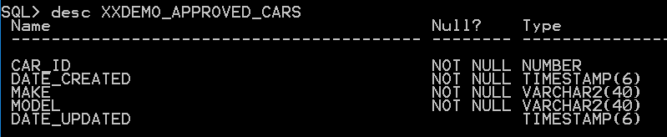
1 - Create Table – Defining new table in Oracle
-------------------------------------------------------------------------------
-- Filename: XXDEMO_APPROVED_CARS_TAB sql --
-- Author: Jim Slanker --
-- Date: May 25th 2022 --
-- Table creation script for XXDEMO_APPROVED_CARS table --
-------------------------------------------------------------------------------
PROMPT >>>>>>>>>>>>>>>>>>>>>>>>>>>>>>>>>>>>>>>>>>>>>>>>>>>>>>>>>>>>>>>>>>>>>>>>>
PROMPT >> Step #1 >>
PROMPT >> DROP Table XXDEMO_APPROVED_CARS >>
PROMPT >>>>>>>>>>>>>>>>>>>>>>>>>>>>>>>>>>>>>>>>>>>>>>>>>>>>>>>>>>>>>>>>>>>>>>>>>
DROP TABLE XXDEMO_APPROVED_CARS;
PROMPT >>>>>>>>>>>>>>>>>>>>>>>>>>>>>>>>>>>>>>>>>>>>>>>>>>>>>>>>>>>>>>>>>>>>>>>>>
PROMPT >> Step #2 >>
PROMPT >> Create Table XXDEMO_APPROVED_CARS >>
PROMPT >>>>>>>>>>>>>>>>>>>>>>>>>>>>>>>>>>>>>>>>>>>>>>>>>>>>>>>>>>>>>>>>>>>>>>>>>
CREATE TABLE XXDEMO_APPROVED_CARS
(
CAR_ID NUMBER NOT NULL,
DATE_CREATED TIMESTAMP(6) NOT NULL,
MAKE VARCHAR2(40) NOT NULL,
MODEL VARCHAR2(40) NOT NULL,
DATE_UPDATED TIMESTAMP(6),
PRIMARY KEY (CAR_ID));
PROMPT is SQLPLUS command used to display during execution
Command to Drop Table
PROMPT is SQLPLUS command used to display during execution
Command to Create Table
NOT NULL indicates the column must have a value for Insert or Update statements
To view table definition use DESC and table name to Describe the table definition
All tables should have a primary key. If the data stored in the table does have a unique numeric value that could be made as the primary key, otherwise it is common to create a numeric _ID field that gets sequentially assigned by the use of an Oracle Sequence. It is possible to use an alphanumeric fields for a primary key, but this could have performance impact as alphanumeric data ususually takes up more room than numeric. *Note primary keys can be a combination of multiple columns in the table.

Slide 3
2 - Alter Table – Change Table Definition
-------------------------------------------------------------------------------
-- Filename: XXDEMO_APPROVED_CARS_ALTERTAB sql --
-- Author: Jim Slanker --
-- Date: May 25th 2022 --
-- Table alter script for XXDEMO_APPROVED_CARS table --
-------------------------------------------------------------------------------
PROMPT >>>>>>>>>>>>>>>>>>>>>>>>>>>>>>>>>>>>>>>>>>>>>>>>>>>>>>>>>>>>>>>>>>>>>>>>>
PROMPT >> Step #1 >>
PROMPT >> Alter Table XXDEMO_APPROVED_CARS ADD COLUMN DESCRIPTION >>
PROMPT >>>>>>>>>>>>>>>>>>>>>>>>>>>>>>>>>>>>>>>>>>>>>>>>>>>>>>>>>>>>>>>>>>>>>>>>>
ALTER TABLE XXDEMO_APPROVED_CARS
ADD DESCRIPTION VARCHAR2(2000);
PROMPT >>>>>>>>>>>>>>>>>>>>>>>>>>>>>>>>>>>>>>>>>>>>>>>>>>>>>>>>>>>>>>>>>>>>>>>>>
PROMPT >> Step #2 >>
PROMPT >> Alter Table XXDEMO_APPROVED_CARS Modify DESCRIPTION to NOT NULL >>
PROMPT >>>>>>>>>>>>>>>>>>>>>>>>>>>>>>>>>>>>>>>>>>>>>>>>>>>>>>>>>>>>>>>>>>>>>>>>>
ALTER TABLE XXDEMO_APPROVED_CARS
MODIFY DESCRIPTION NOT NULL;
PROMPT >>>>>>>>>>>>>>>>>>>>>>>>>>>>>>>>>>>>>>>>>>>>>>>>>>>>>>>>>>>>>>>>>>>>>>>>>
PROMPT >> Step #3 >>
PROMPT >> Alter Table XXDEMO_APPROVED_CARS Modify DESCRIPTION to Allow NULL >>
PROMPT >>>>>>>>>>>>>>>>>>>>>>>>>>>>>>>>>>>>>>>>>>>>>>>>>>>>>>>>>>>>>>>>>>>>>>>>>
ALTER TABLE XXDEMO_APPROVED_CARS
MODIFY DESCRIPTION NULL;
PROMPT >>>>>>>>>>>>>>>>>>>>>>>>>>>>>>>>>>>>>>>>>>>>>>>>>>>>>>>>>>>>>>>>>>>>>>>>>
PROMPT >> Step #4 >>
PROMPT >> Alter Table XXDEMO_APPROVED_CARS Modify DESCRIPTION to 400 chars >>
PROMPT >>>>>>>>>>>>>>>>>>>>>>>>>>>>>>>>>>>>>>>>>>>>>>>>>>>>>>>>>>>>>>>>>>>>>>>>>
ALTER TABLE XXDEMO_APPROVED_CARS
MODIFY DESCRIPTION VARCHAR2(400);
PROMPT >>>>>>>>>>>>>>>>>>>>>>>>>>>>>>>>>>>>>>>>>>>>>>>>>>>>>>>>>>>>>>>>>>>>>>>>>
PROMPT >> Step #5 >>
PROMPT >> Alter Table XXDEMO_APPROVED_CARS Drop Column DESCRIPTION >>
PROMPT >>>>>>>>>>>>>>>>>>>>>>>>>>>>>>>>>>>>>>>>>>>>>>>>>>>>>>>>>>>>>>>>>>>>>>>>>
ALTER TABLE XXDEMO_APPROVED_CARS
DROP COLUMN DESCRIPTION;
This script demonstrates altering a table. You can add, modify or delete columns
In this example it creates a new column named DESCRIPTION, then modifies it to be Not Null, then modifies it to allow Null and then changes the data type from VARCHAR2(2000) to VARCHAR2(400) and the last step drops the column

Slide 4
3 - Sequence Creation / Definition
-------------------------------------------------------------------------------
-- Filename: XXDEMO_CAR_SEQ.sql --
-- Author: Jim Slanker --
-- Date: May 25th 2022 --
-- Sequence creation script for XXDEMO_CAR_SEQ used to generate the CAR_ID --
-------------------------------------------------------------------------------
DROP SEQUENCE XXDEMO_CAR_SEQ;
CREATE SEQUENCE XXDEMO_CAR_SEQ
START WITH 1
MAXVALUE 999999999999999999999999999
MINVALUE 1
NOCYCLE
CACHE 20
NOORDER;
Sequences are commonly used to assign primary ID column values. But also could be used for other purposes.
Example Creating a unique serial number. A serial number could be made up of
‘SN’ + 4 digit Year + a sequentially assigned number of a set number of digits.
SN20220001
SN20220002
…
SN20224023
In this case Max value would be 9999 and instead of the keyword NOCYCLE the sequence would have CYCLE. And if needed the sequence could be reset by code to 1 at the beginning of the next year.

Slide 5
4 - Assignment of Primary Key values
#1 Using Sequence with DEFAULT, *Note Sequence must be created prior
#2 Using Database Trigger on Insert to default values
-------------------------------------------------------------------------------
-- Filename: XXDEMO_APPROVED_CARS_TAB2.sql --
-- Author: Jim Slanker --
-- Date: May 25th 2022 --
-- Table creation script for XXDEMO_APPROVED_CARS table default Primary Key --
-------------------------------------------------------------------------------
PROMPT >>>>>>>>>>>>>>>>>>>>>>>>>>>>>>>>>>>>>>>>>>>>>>>>>>>>>>>>>>>>>>>>>>>>>>>>>
PROMPT >> Step #1 >>
PROMPT >> DROP Table XXDEMO_APPROVED_CARS >>
PROMPT >>>>>>>>>>>>>>>>>>>>>>>>>>>>>>>>>>>>>>>>>>>>>>>>>>>>>>>>>>>>>>>>>>>>>>>>>
DROP TABLE XXDEMO_APPROVED_CARS;
PROMPT >>>>>>>>>>>>>>>>>>>>>>>>>>>>>>>>>>>>>>>>>>>>>>>>>>>>>>>>>>>>>>>>>>>>>>>>>
PROMPT >> Step #2 >>
PROMPT >> Create Table XXDEMO_APPROVED_CARS >>
PROMPT >>>>>>>>>>>>>>>>>>>>>>>>>>>>>>>>>>>>>>>>>>>>>>>>>>>>>>>>>>>>>>>>>>>>>>>>>
CREATE TABLE XXDEMO_APPROVED_CARS
(
CAR_ID NUMBER DEFAULT XXDEMO_CAR_SEQ.nextval NOT NULL,
DATE_CREATED TIMESTAMP(6) DEFAULT SYSDATE NOT NULL,
MAKE VARCHAR2(40) NOT NULL,
MODEL VARCHAR2(40) NOT NULL,
DATE_UPDATED TIMESTAMP(6),
PRIMARY KEY (CAR_ID));
--------------------------------------------------------------------------------
-- Filename: XXDEMO_APP_CAR_BI_CR.trg --
-- Author: Jim Slanker --
-- Date: May 25th 2022 --
--------------------------------------------------------------------------------
CREATE OR REPLACE TRIGGER XXDEMO_APP_CAR_BI_CR BEFORE INSERT
ON SANDBOX.XXDEMO_APPROVED_CARS REFERENCING OLD AS OLD NEW AS NEW FOR EACH ROW
--------------------------------------------------------------------------------
-- Before Insert Trigger on table XXDEMO_APPROVED_CARS --
-- Author: Jim Slanker created May 25th 2022 --
--------------------------------------------------------------------------------
DECLARE
-------------------------------------------------------------------------------
-- B E G I N Trigger Code --
-------------------------------------------------------------------------------
BEGIN
-----------------------------------------------------------------------------
-- Assign Default Values --
-----------------------------------------------------------------------------
:NEW.DATE_CREATED := SYSDATE;
------------------------------------------------------
-- Assign primary key CAR_ID from sequence --
------------------------------------------------------
:NEW.CAR_ID := XXDEMO_CAR_SEQ.nextval;
-------------------------------------------------------------------------------
-- E N D Trigger Code --
-------------------------------------------------------------------------------
END;
/
#3 New option available starting with 19C version of Oracle Database
CREATE TABLE xxjs_queue
(
qname_id integer GENERATED BY DEFAULT AS IDENTITY (START WITH 1) NOT NULL PRIMARY KEY,
qname VARCHAR2(4000) NOT NULL -- CONSTRAINT qname_uk UNIQUE
);
With this option it automatically generates a Sequence and is much like Option #1

Slide 6
5 - Table Constraints – Enforce Data Validition
CREATE TABLE XXDEMO_COMPANY_CARS
(
COMPANY_CAR_ID NUMBER DEFAULT XXDEMO_COMPANY_CAR_SEQ.nextval NOT NULL,
CAR_ID NUMBER NOT NULL,
MODEL_YEAR NUMBER NOT NULL,
VIN VARCHAR2(40) NOT NULL,
EMPLOYEE_ID NUMBER NOT NULL,
DATE_CREATED TIMESTAMP(6) NOT NULL,
DATE_UPDATED TIMESTAMP(6),
PRIMARY KEY (COMPANY_CAR_ID));
--------------------------------------------------------------------------------
-- Filename: XXDEMO_COMPANY_CAR_CONTRAINTS --
-- Author: Jim Slanker --
-- Date: May 25th 2022 --
--------------------------------------------------------------------------------
PROMPT >>Create Constraints for Table XXDEMO_COMPANY_CARS
ALTER TABLE XXDEMO_COMPANY_CARS ADD (
CONSTRAINT XXCCAR_CK1
CHECK (MODEL_YEAR IN (2021,2022,2023,2024))
ENABLE VALIDATE,
CONSTRAINT XXCCAR_XXACAR_FK
FOREIGN KEY (CAR_ID)
REFERENCES XXDEMO_APPROVED_CARS (CAR_ID)
ENABLE VALIDATE);
-------------------------------------------------------------------------------
-- Filename: XXDEMO_APPROVED_CARS_TAB sql --
-- Author: Jim Slanker --
-- Date: May 25th 2022 --
-- Table creation script for XXDEMO_APPROVED_CARS table --
-------------------------------------------------------------------------------
PROMPT >>>>>>>>>>>>>>>>>>>>>>>>>>>>>>>>>>>>>>>>>>>>>>>>>>>>>>>>>>>>>>>>>>>>>>>>>
PROMPT >> Step #1 >>
PROMPT >> DROP Table XXDEMO_APPROVED_CARS >>
PROMPT >>>>>>>>>>>>>>>>>>>>>>>>>>>>>>>>>>>>>>>>>>>>>>>>>>>>>>>>>>>>>>>>>>>>>>>>>
DROP TABLE XXDEMO_APPROVED_CARS;
PROMPT >>>>>>>>>>>>>>>>>>>>>>>>>>>>>>>>>>>>>>>>>>>>>>>>>>>>>>>>>>>>>>>>>>>>>>>>>
PROMPT >> Step #2 >>
PROMPT >> Create Table XXDEMO_APPROVED_CARS >>
PROMPT >>>>>>>>>>>>>>>>>>>>>>>>>>>>>>>>>>>>>>>>>>>>>>>>>>>>>>>>>>>>>>>>>>>>>>>>>
CREATE TABLE XXDEMO_APPROVED_CARS
(
CAR_ID NUMBER NOT NULL,
DATE_CREATED TIMESTAMP(6) NOT NULL,
MAKE VARCHAR2(40) NOT NULL,
MODEL VARCHAR2(40) NOT NULL,
DATE_UPDATED TIMESTAMP(6),
PRIMARY KEY (CAR_ID));
In the above example it creates two constraints
The first one ensures the values inserted or updated into MODEL_YEAR have the values of 2021, 2022, 2023 or 2024
The Second constraint ensures the value of CAR_ID in XXDEMO_COMPANY_CARS has a corresponding entry in the table XXDEMO_APPROVED_CARS table

Slide 7
6 - Table Triggers / Code fires on Insert, Update or Delete on Table
Triggers are PL/SQL Code objects that are executed when an Insert, Update or Delete is performed against a specific table. These triggers can run before or after the Insert, Update or Delete. They can be used for many purposes
Defaulting of data values
Enforcement of data values
Creating a log of the table activity and log before and after data values
Perform Insert, Update and Delete on other tables
Used to trigger a stored PL/SQL procedure or Function
Used to create an interface from external systems
The Trigger code in the next slide is based on the following table. The table creation script contains comments as to what validation will occur in an insert trigger on the table.
CREATE TABLE XXJS_EMPLOYEES
(
EMPLOYEE_ID NUMBER DEFAULT XXJS_EMP_SEQ.nextval NOT NULL ,
NAME VARCHAR2(40) NOT NULL,
EMPLOYEE_TYPE VARCHAR2(10) NOT NULL, --SALARY,HOURLY,1099
DATE_CREATED TIMESTAMP(6) DEFAULT SYSDATE NOT NULL,
DATE_UPDATED TIMESTAMP(6),
FED_SSN NUMBER, --Length must be 9 digits, required for SALARY and HOURLY
FED_EIN NUMBER, --Length must be 9 digits 1099 Employees need this value or FED_SSN
HOURLY_RATE NUMBER, --Required when EMPLOYEE_TYPE = HOURLY or 1099
ANNUAL_SALARY NUMBER, --Required when EMPLOYEE_TYPE = SALARY
FAVORITE_COLOR_ID NUMBER, --Create Foreign Key constraint to COLOR_ID in XXHR_COLORS
PAYROLL_YTD NUMBER,
HIRE_DATE DATE NOT NULL,
TERMINATION_DATE DATE,
WORK_STATE VARCHAR2(40),
WORK_CITY VARCHAR2(40),
PRIMARY KEY (EMPLOYEE_ID));
Within the Trigger code you can reference the column values before the Insert or Update using the prefix of :OLD.
And you can reference the updated values using the prefix of :NEW.

Slide 8
6 – Insert Update Trigger Example 1 – Data Validation
CREATE OR REPLACE TRIGGER XXJSEMP_BIU_CR BEFORE INSERT or UPDATE
ON XXJS_EMPLOYEES REFERENCING OLD AS OLD NEW AS NEW FOR EACH ROW
--------------------------------------------------------------------------------
-- Before Insert Trigger on table XXJS_EMPLOYEES --
-- Author: Jim Slanker created May 18th 2022 --
--------------------------------------------------------------------------------
DECLARE
-------------------------------------------------------------------------------
-- B E G I N Trigger Code --
-------------------------------------------------------------------------------
BEGIN
-----------------------------------------------------------------------------
-- If FED_SSN entered ensure it contains 9 digits --
-----------------------------------------------------------------------------
IF :NEW.FED_SSN is not null THEN
IF LENGTH(:NEW.FED_SSN) <> 9 THEN
raise_application_error(-20900,'cannot insert row. FED_SSN must be 9 digits');
END IF;
END IF;
-----------------------------------------------------------------------------
-- If FED_EIN entered ensure it contains 9 digits --
-----------------------------------------------------------------------------
IF :NEW.FED_EIN is not null THEN
IF LENGTH(:NEW.FED_EIN) <> 9 THEN
raise_application_error(-20901,'cannot insert row. FED_EIN must be 9 digits');
END IF;
END IF;
-----------------------------------------------------------------------------
-- Validate if EMPLOYEE_TYPE = SALARY or HOURLY must have FED_SSN --
-----------------------------------------------------------------------------
IF :NEW.EMPLOYEE_TYPE in ('SALARY','HOURLY') THEN
IF :NEW.FED_SSN is null THEN
raise_application_error(-20902,'cannot insert row. FED_SSN is required for SALARY and HOURLY Employees');
END IF;
END IF;
-----------------------------------------------------------------------------
-- Validate if EMPLOYEE_TYPE = 1099 must have either FED_SSN or FED_EIN --
-----------------------------------------------------------------------------
IF :NEW.EMPLOYEE_TYPE = '1099' THEN
IF :NEW.FED_SSN is null and :NEW.FED_EIN is null THEN
raise_application_error(-20903,'cannot insert row. FED_SSN or FED_EIN required for 1099 Employees');
END IF;
END IF;
-----------------------------------------------------------------------------
-- Validate that FED_SSN and FED_EIN are both entered. Can only have one --
-----------------------------------------------------------------------------
IF :NEW.FED_SSN is not null and :NEW.FED_EIN is not null THEN
raise_application_error(-20904,'cannot insert row. Cannot specify both FED_SSN and FED_EIN');
END IF;
-------------------------------------------------------------------------------
-- E N D Trigger Code --
-------------------------------------------------------------------------------
END;
/
The raise_application_error causes the INSERT or UPDATE statement to fail. The code issuing the INSERT or UPDATE can check for the user error code raised. *Note trigger name contains BIU for Before Insert Update

Slide 9
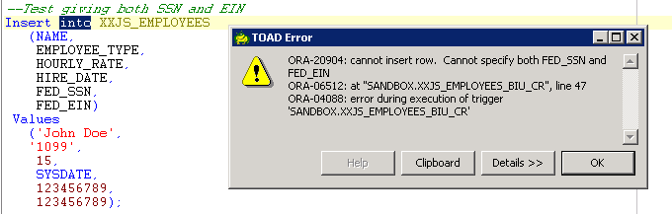
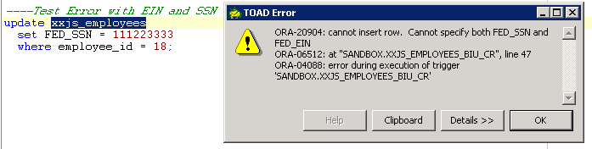
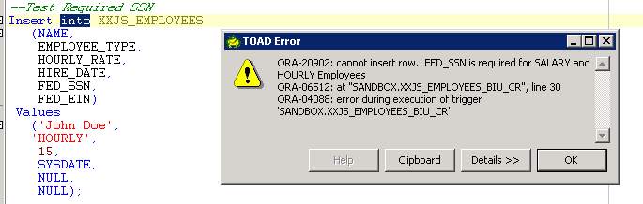
6 – Insert Update Trigger Example 1 – Data Validation
Testing Insert and Update statements on table XXJS_EMPLOYEES

Slide 10
6 – Update Delete Trigger Example 2– Data Auditing
CREATE OR REPLACE TRIGGER XXACAR_BUD_R BEFORE UPDATE or DELETE
ON XXDEMO_APPROVED_CARS REFERENCING OLD AS OLD NEW AS NEW FOR EACH ROW
--------------------------------------------------------------------------------
-- Before Update or Delete Trigger on table XXDEMO_APPROVED_CARS --
-- Author: Jim Slanker created May 25th 2022 --
--------------------------------------------------------------------------------
DECLARE
lvTableName VARCHAR2(40) := 'XXDEMO_APPROVED_CARS';
lvAction VARCHAR2(40);
-------------------------------------------------------------------------------
-- B E G I N Trigger Code --
-------------------------------------------------------------------------------
BEGIN
IF UPDATING THEN
lvAction := 'UPDATE';
----------------------------------------------------------------------------
-- Default value of DATE_UPDATED to current system date --
----------------------------------------------------------------------------
:NEW.DATE_UPDATED := SYSDATE;
-----------------------------------------------------------------------------
-- Check if MAKE has changed --
-----------------------------------------------------------------------------
IF :NEW.MAKE <> :OLD.MAKE then
INSERT INTO XXDEMO_AUDITS(ACTION,
PRIMARY_KEY_VALUE,
TABLE_NAME,
COLUMN_NAME,
PREVIOUS_VALUE,
NEW_VALUE)
VALUES (lvAction,
:NEW.CAR_ID,
lvTableName,
'MAKE',
:OLD.MAKE,
:NEW.MAKE);
END IF;
-----------------------------------------------------------------------------
-- Check if MODEL has changed --
-----------------------------------------------------------------------------
IF :NEW.MODEL <> :OLD.MODEL then
INSERT INTO XXDEMO_AUDITS(ACTION,
PRIMARY_KEY_VALUE,
TABLE_NAME,
COLUMN_NAME,
PREVIOUS_VALUE,
NEW_VALUE)
VALUES (lvAction,
:NEW.CAR_ID,
lvTableName,
'MODEL',
:OLD.MODEL,
:NEW.MODEL);
END IF;
END IF;
IF DELETING THEN
lvAction := 'DELETE';
--Post MAKE info to AUDIT Table
INSERT INTO XXDEMO_AUDITS(ACTION,
PRIMARY_KEY_VALUE,
TABLE_NAME,
COLUMN_NAME,
PREVIOUS_VALUE)
VALUES (lvAction,
:OLD.CAR_ID,
lvTableName,
'MAKE',
:OLD.MAKE);
--Post MODEL info to AUDIT Table
INSERT INTO XXDEMO_AUDITS(ACTION,
PRIMARY_KEY_VALUE,
TABLE_NAME,
COLUMN_NAME,
PREVIOUS_VALUE)
VALUES (lvAction,
:OLD.CAR_ID,
lvTableName,
'MODEL',
:OLD.MODEL);
END IF;
-------------------------------------------------------------------------------
-- E N D Trigger Code --
-------------------------------------------------------------------------------
END;
/
*this trigger also assigns DATE_UPDATED value on UPDATES

Slide 11
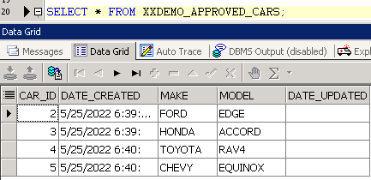
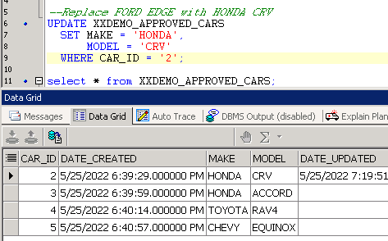
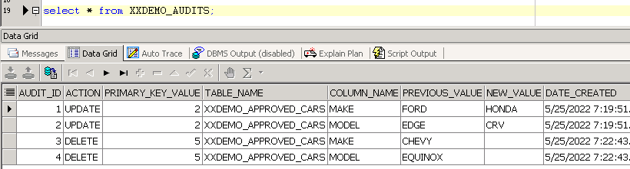
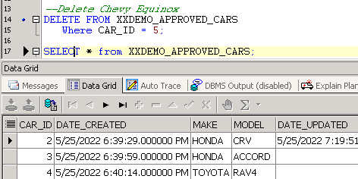
6 – Update Delete Trigger Example 2 – Data Auditing
Query Audits table after Update and Delete testing
Testing Update and Delete statements on XXDEMO_APPROVED_CARS

Slide 12
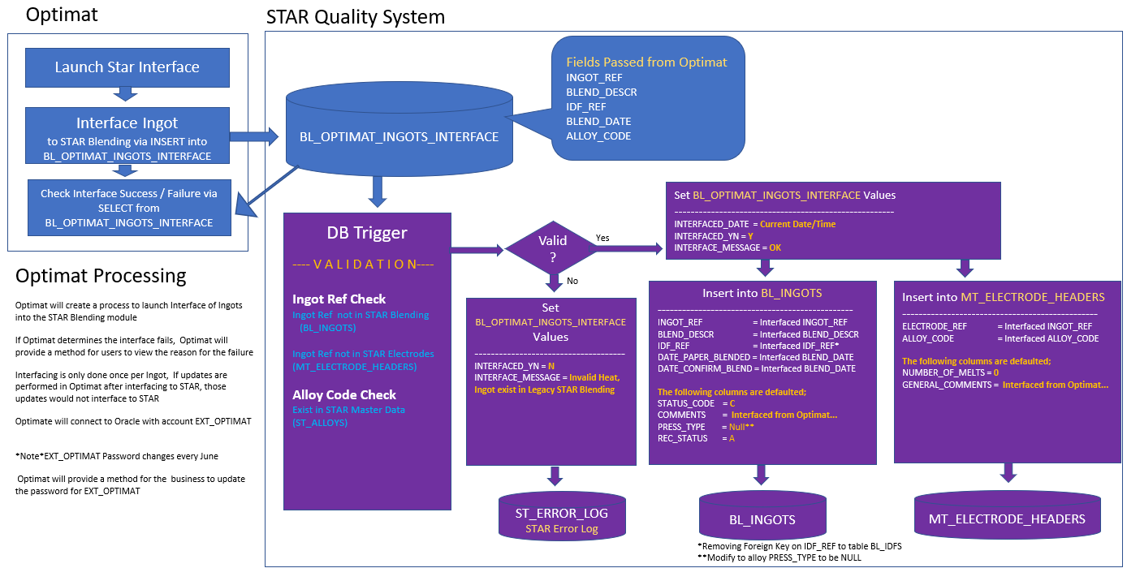
6 – Trigger Example 3 – Table + Trigger Interface into STAR Blending

Slide 13
6 – Trigger Example 3 – Table + Trigger Interface into STAR Blending
-------------------------------------------------------------------------------
-- Filename: BL_OPTIMAT_INGOTS_INTERFACE_tab.sql --
-- Author: Jim Slanker --
-- Date: May 9th 2022 --
-- Table creation script for BL_OPTIMAT_INGOTS_INTERFACE --
-------------------------------------------------------------------------------
PROMPT >>Create new Table BL_OPTIMAT_INGOTS_INTERFACE
DROP TABLE STAR.BL_OPTIMAT_INGOTS_INTERFACE;
CREATE TABLE STAR.BL_OPTIMAT_INGOTS_INTERFACE
(
INGOT_REF VARCHAR2(8) NOT NULL,
BLEND_DESCR VARCHAR2(1000),
IDF_REF VARCHAR2(4) NOT NULL,
BLEND_DATE DATE NOT NULL,
ALLOY_CODE VARCHAR2(19) NOT NULL,
DATE_CREATED TIMESTAMP(6) NOT NULL,
INTERFACED_DATE TIMESTAMP(6),
INTERFACED_YN VARCHAR2(1),
INTERFACED_MESSAGE VARCHAR2(2000),
PRIMARY KEY (INGOT_REF));
COMMENT ON TABLE STAR.BL_OPTIMAT_INGOTS_INTERFACE IS 'This table will be used to interface heats from Optimat into BL_INGOTS and MT_ELECTRODE_HEADERS Tables';
CREATE OR REPLACE PUBLIC SYNONYM BL_OPTIMAT_INGOTS_INTERFACE FOR STAR.BL_OPTIMAT_INGOTS_INTERFACE;
GRANT DELETE, INSERT, SELECT, UPDATE ON STAR.BL_OPTIMAT_INGOTS_INTERFACE TO STAR_USER;
GRANT INSERT, SELECT on STAR.BL_OPTIMAT_INGOTS_INTERFACE to EXT_OPTIMAT;
Passed in Insert Statement from external system (Optimat)
Set by Trigger code and then read by external system (Optimat) with Select Statement to check if Interface was Successful
Click this to see actual Trigger code for the Optimat to STAR Blending Interface →

Slide 14
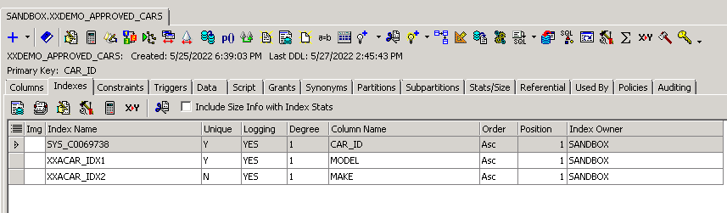
7 - Table Indexes / Improve performance / Enforce Uniqueness
-------------------------------------------------------------------------------
-- Filename: XXDEMO_APPROVED_CARS_INDEXES.sql --
-- Author: Jim Slanker --
-- Date: May 25th 2022 --
-- Index creation script for Index on XXDEMO_APPROVED_CARS table --
-------------------------------------------------------------------------------
PROMPT >>Create Unique Index on MODEL in XXDEMO_APPROVED_CARS
CREATE UNIQUE INDEX XXACAR_IDX1 ON XXDEMO_APPROVED_CARS
(MODEL);
PROMPT >>Create Non Unique Index on MAKE in XXDEMO_APPROVED_CARS
CREATE INDEX XXACAR_IDX2 ON XXDEMO_APPROVED_CARS
(MAKE);
In this example two indexes are created on the XXDEMO_APPROVED_CARS table. The first is unique and will limit the ability to insert more than one row with the same MODEL value.
Both indexes can improve performance when querying
Notice the index SYS_C0069738, this was generated by the system because the CAR_ID field was specified as the Primary Key

